Slide 1

Arduino Based Gesture Controlled Rover
DR Group Number : 10
122CS0069 – Aditya
122CS0047 – Shubhankar Bhattacharya
122CS0072 – Ayush Mishra
122CS0032 - Ashutosh Mishra
122CS0058 – Ravi Shankar Kumar Yadav
122EC0021 – Hitesh Bhoyar
122EC0041 - Anjan Kumar Sharma
122EC0001 – Kruti Khemraj Lengure
122ME0024 - Rubham Singh
122ME0028 – Aditya Kumar Rai
122ME0031 – Harshvardhan Giri
Notes:
Welcome everyone, This is Aditya from computer department. So, our project is based on Arduino based gesture controlled rover. So, this is our group.

Slide 2

Introduction
Gesture controlled robots, which allow users to control their mobile robot by hand gestures are a popular and exciting application of robotics.
In a wide variety of fields such as military, surveillance and research, these types of rovers could be employed.
An Arduino-based gesture-controlled rover is a mobile robot that can be controlled using controller movement, which are detected by MPU 6050 Accelerometer Gyroscope sensor.
Notes:
So, lets gets started with the introductions. GBR is a robot which work on gesture inputed by the user. So, It has a lot of implications of this it has its uses in military, research and surveillance.
Moving on to our project it is contolled by a controller and is primararily working like a steering wheel like moving (*Move hand left*) just similar to a gyroscope. This would be achieved by The sensor given above.

Slide 3

PRELIMINARY STUDIES
Before designing and building an Arduino-based gesture-controlled rover, it is essential to conduct some preliminary studies to understand the various components and technologies involved. Here are some important preliminary studies to consider:
Arduino programming.
Motion recognition technology (MPU 6050 Accelerometer).
Rover design.
Motor control.
Sensor integration.
By considering these preliminary studies, we can lay a strong foundation for designing and building an Arduino-based gesture-controlled rover that meets our requirements.
Notes:
However any project must have a preliminary study to be done and conducted, so based on our requirements we came up with this set of ideas. (*List of each point mentioned*). By following these we could have a rough estimate of how to go about the project.

Slide 4

Objectives
To design and build a functioning gesture-controlled rover.
To develop a reliable and accurate Motion recognition system.
To achieve precise control of the rover's motors.
To integrate various sensors into the rover.
To optimize the design of the rover.
To program the Arduino board.
To develop a user-friendly interface.
To explore the potential applications .
By achieving these objectives, you can create a functioning and effective Arduino-based gesture-controlled rover that has a range of potential applications and demonstrates our skills in robotics, programming, and engineering.
Notes:
Now ffrom the section prior we could now indulge ourselves in the objectives of this project. Basically, we would learn how many different components and workings are done in a project. Related teamwork and
Well defined Coordination amongst different departments to bring the project to fruition.

Slide 5

Responsibility Of Each Member
Computer Science students:
Software development for gesture recognition algorithm.
Programming the microcontroller to interface with sensors and motor controller.
Developing user interface for the gesture-controlled rover.
Mechanical Engineering students:
Design and assembly of the Rover chassis.
Selection and installation of the necessary mechanical components, such as wheels and motors.
Integration of the motor controller with the mechanical components.
Electrical Engineering students:
Design and assembly of the electrical system.
Selection and installation of sensors and actuators.
Integration of the sensors with the microcontroller.
Notes:
Lets talk about t he work distribution of each department. The computer students would learn the coding and making a interface of the project. The mechanical students would design
The chasis and integrate different physical components of the project and the electrical department would design the circuit and do the required connections and electronics stuff.

Slide 6

Work done so far ( Computer DEPT.)
Learning of the required language and familiarizing with the programming environment.
Notes:
Moving on to the work done by the computer department so, we familiarized ourself with the programming environment and language.

Slide 7
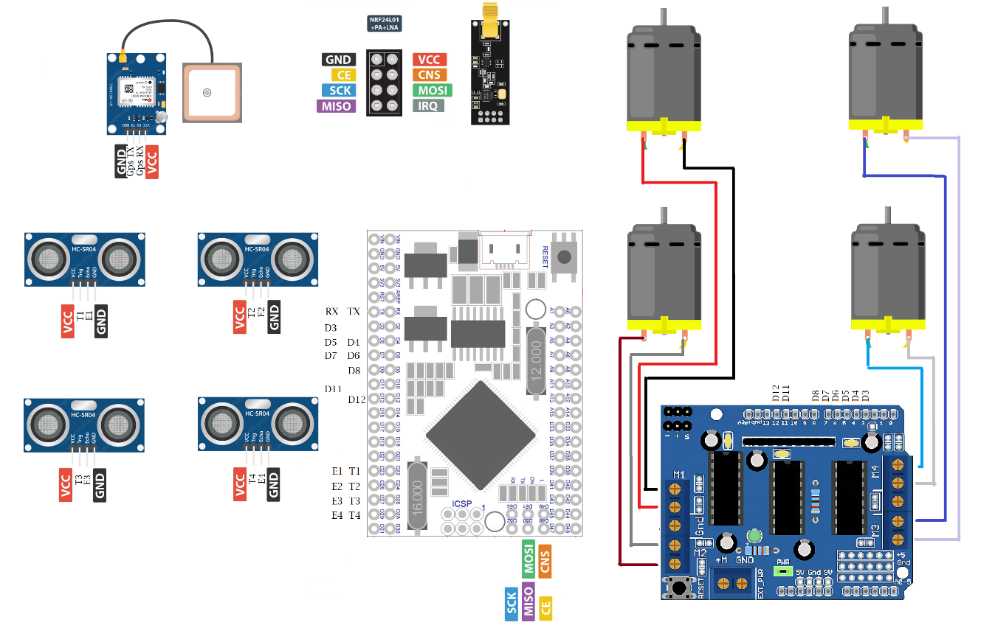
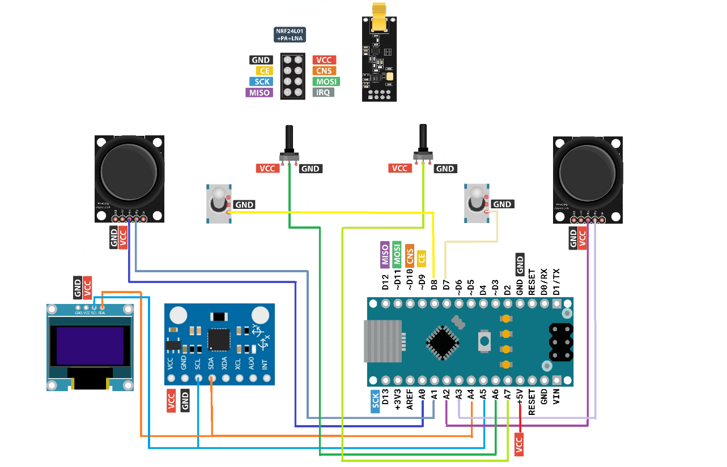
Work done so far (ELEC. DEPT.)
Identifying the key electrical components and deciding an Arduino circuit board.
Lear the functioning of Electronics.
Designing a circuit diagram.
Notes:
Next to the electrical department’s work, they have already made a circuit diagram as mentioned and even selected the key components.

Slide 8
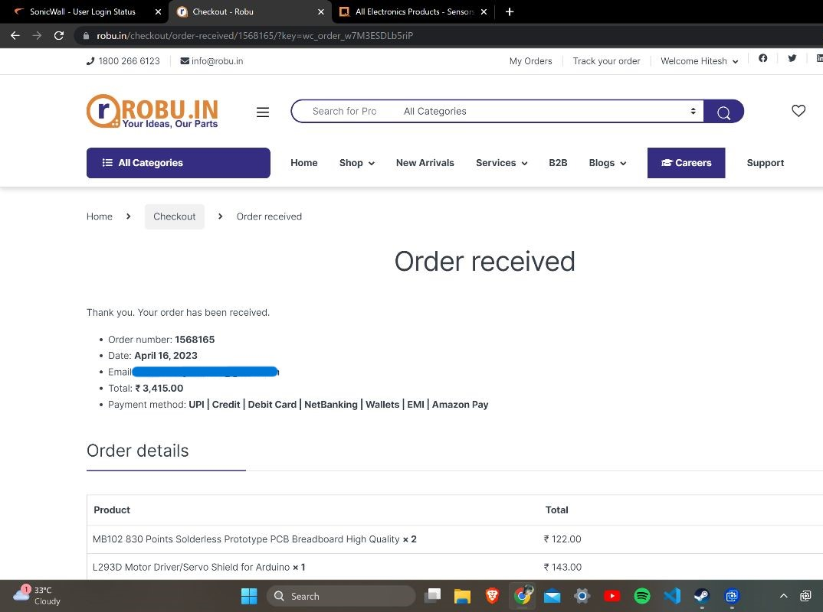
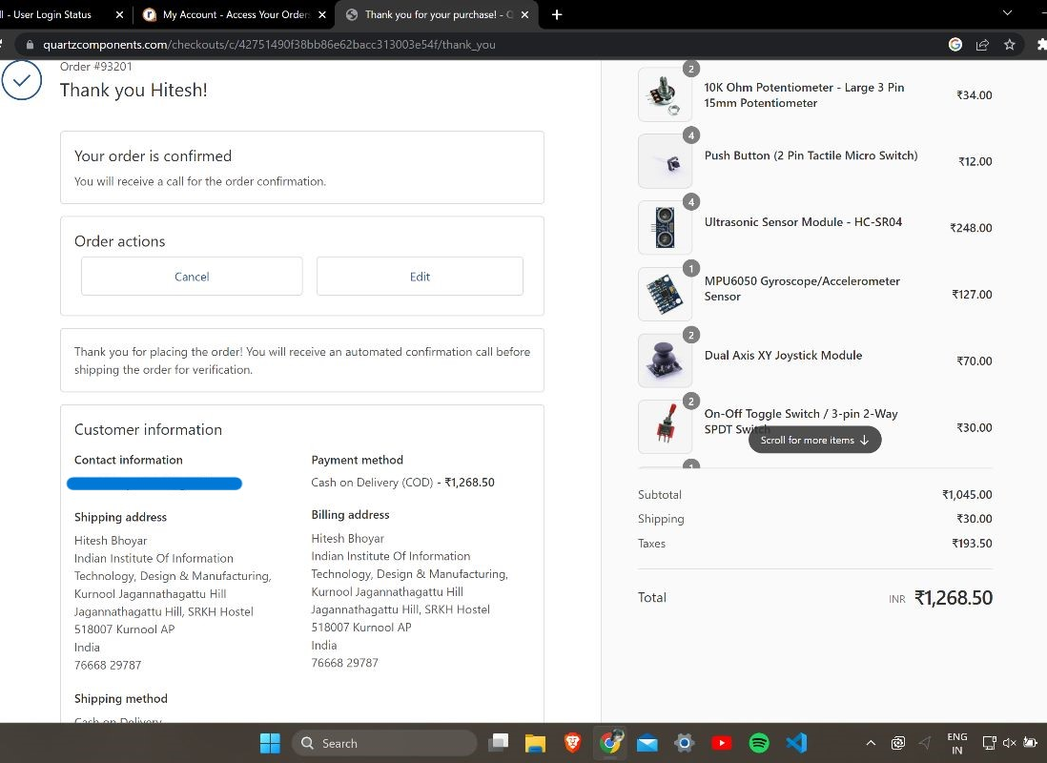
Work Done So Far (Mech. DePT.)
Identifying the material and framework of the project.
Buying of various key components.
Notes:
Now to the mechanical department’s work. They have placed order for the project and they have even identified the materials to be used for the main frame work of the project.

Slide 9

Work to be done
Since the basics are well covered and learned. Our problems now include:
Design and fabrication of the Rover chassis.
Assembly and mounting of components.
Integration with electrical system.
Sensor integration.
Gesture recognition algorithm.
Motor control.
Integration and testing.
User interface.
Notes:
On to the last section of this the work to be done. The designing, assembling, testing, R&D stuff and improvising the whole project to be even better. And now concluding the entire presentation, I would like to thank our teachers for providing us with a wonderful opportunity to present ourself and bring about the innovative creative side of us. THANK YOU.

